Slide 1
Multi-threading and Free RTOS using Arduino IDE in ESP32 and ESP8266
Saleem Elias
Inter-Disciplinary center for Smart Technologies
Technion CS

Slide 2
What is a thread?
a thread of execution is a process that runs upon one of the cores provided in the unit (either it be a microcontroller unit or a full-fledged Intel/Amd CPU).
In ESP32 and other microcontrollers, we can use an operating system for handling “threads”, it is called FreeRTOS.

Slide 3
Why do we use multiple threads?
Multi-threading is useful when wanting to preform multiple tasks at the same time, the operating system provides a scheduler which can give the feeling of multiple processes running at the same time. When wanting to preform multiple checks that have *blocking code, multi-threading can be a very efficient tool to perform both tasks without much code overhead.
Notes:
A blocking code is a code that stops the program from continuing its execution until a specific event happens.
- Check Scheduling and Time Measurement using ESP32 in Arduino IDE in the knowledge bank for more information.

Slide 4
What is an RTOS?
An RTOS, or a Real Time Operating System, is basically an operating system which includes a scheduler for executing different tasks in a predictable manner.
Traditional RTOS’s achieve this predictability by allowing the user to assign each thread of execution a priority.

Slide 5
What is FreeRTOS?
FreeRTOS is an RTOS which is designed to run on microcontrollers such as ESP32 and ESP8266.
Unlike regular UNIX threads, “threads” in FreeRTOS are called tasks, FreeRTOS provides the core real time scheduling functionality, inter-task communication, timing and synchronization primitives only.

Slide 6
Example 1:
We are interested in designing an ESP32 with a button, a beeper and a led, when pressing the button the beeper plays a song and the led starts fading on and off.
We have three functions:
playSong(); // plays a song, takes 1 minute to complete.
fadeLed(); //fades the led light for 1 minute.
checkButton(); //checks if the button was pressed, returns true if pressed and false if not

Slide 7
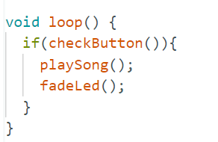
Example 1 (continued):
As said, we are interested in playing the song and fading the led light at the same time, if we write this code:
The problem immediately shows up, if the button is pressed we play the song for 1 minute then we fade, which is not what we wanted, using timers won’t help all that much since the functions are already written and we don’t want to edit them.

Slide 8
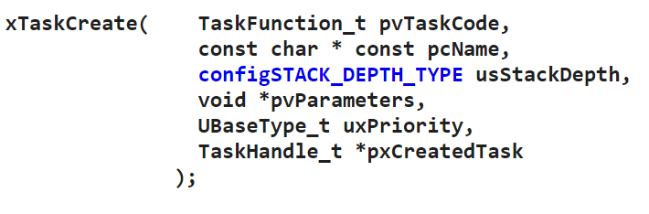
Example 1 (continued):
Solution:
Create a task for each thread and wait for both of them to finish.
But how do we do that?
Definition 1:

Slide 9
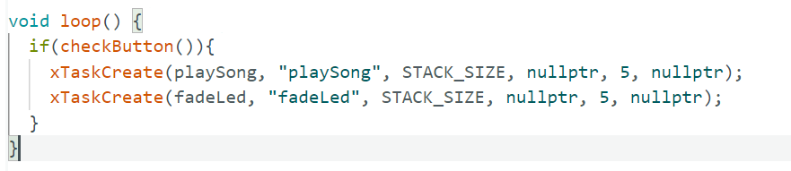

xTaskCreate(…);
The function XTaskCreate looks scary, but it is really simple.
An example of how we would use it in the example:
Where STACK_SIZE is 2048:

Slide 10
xTaskCreate(…);
Explanation for some of the parameters (for the full explanation a link is provided in the presentation notes, though we won’t use many of the parameters).
pvTaskCode is simply a pointer to the function, you can pass the function name as it is.
Note that the entry function should be in this form:
function_name(void* params){
// code
}
Notes:
More on xTaskCreate: https://www.freertos.org/a00125.html

Slide 11
xTaskCreate(…);
Third parameter (usStackDepth) limits how much stack the task (thread) has.
Fourth parameter (pvParameters) is a pointer to a parameter that we want to pass to the thread, this is why the entry function has the *params parameter, the fourth parameter in xTaskCreate is passed there.
The last parameter (pxCreatedTask) is a pointer to the task handle, basically it is used to interact with the task (either kill it or suspend it or…)
xTaskCreate updates the value of the handle to “point” at the task.

Slide 12
Important notes on xTaskCreate(…);
When a thread is done, it cannot return as usual. This would crash the whole ESP chip and there is no easy way to debug it. Rather, the task should either kill itself by using vTaskDelete(nullptr);
Make sure that STACK_SIZE is sufficient, otherwise unexpected behaviour may occur.
FreeRTOS provides priorities for tasks, be careful when using this, it may starve some important task and there is no easy way to know which task is starved (for example a check button task is a high priority task because we cannot miss clicks).

Slide 13
vTaskDelete();
Used for deleting tasks.
If the task wants to delete itself:
vTaskDelete(nullptr);
If another task wants to delete the task it should have a handle, and then pass it to vTaskDelete:
vTaskDelete(handle);
Notes:
For more on vTaskDelete() : https://www.freertos.org/a00126.html

Slide 14
Important notes on vTaskDelete(…);
Be careful that the task is responsible for cleaning allocated memory before killing itself, any memory that hasn’t been freed will remain in use.
It is preferable that a task kills itself internally, from experience, a task deleting another task is prone to bugs and crashes.. The best way is to delete internally. If a parent task wants to delete the child it should pass a flag telling the child to delete itself, by using communication methods (more on that later).
Notes:
For more on vTaskDelete() : https://www.freertos.org/a00126.html

Slide 15
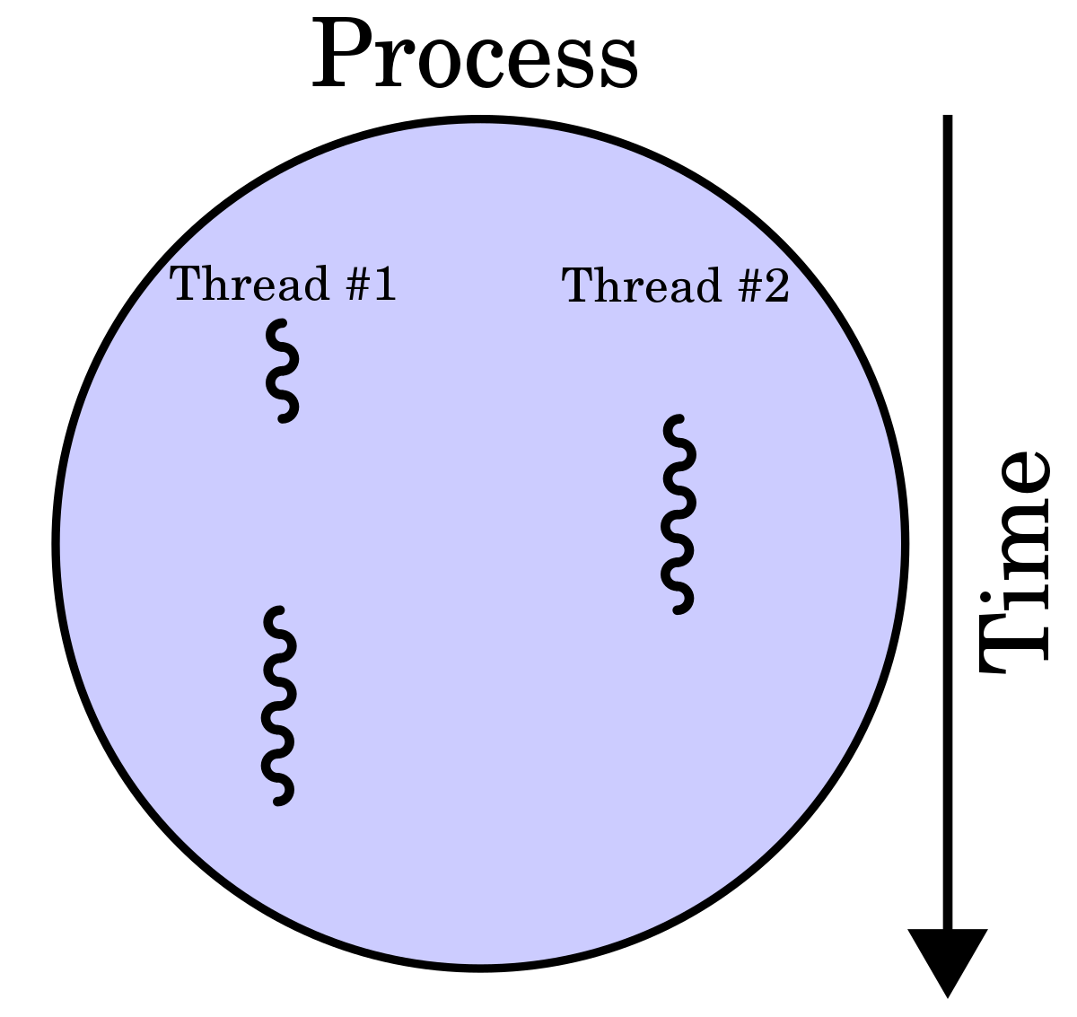
Although multi-tasking can be really useful, it isn’t always the best tool to use. In this part we will expand more on when to use multi-tasks and when not to use it.

Slide 16
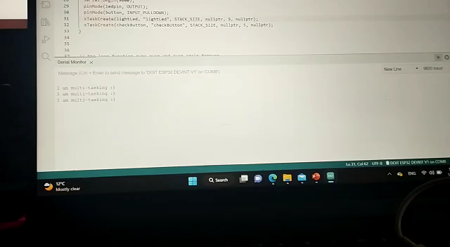
Example 2 – simple button led light:
We are interested in checking a button and lighting a led light when the button is clicked, and at the same time, printing every second to the terminal. A video showing what we expect:

Slide 17
Example 2 – cont
Notice that we have 3 different tasks:
Checking the button.
Lighting the led.
Printing to screen.
In this case, 2 solutions can be used, a software timer or tasks, we are going to use tasks.

Slide 18
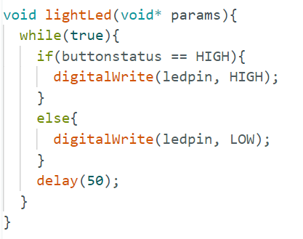
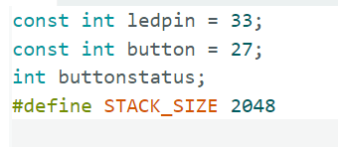
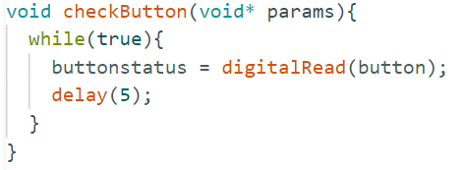
Example 2 – The code
Globals:

Slide 19
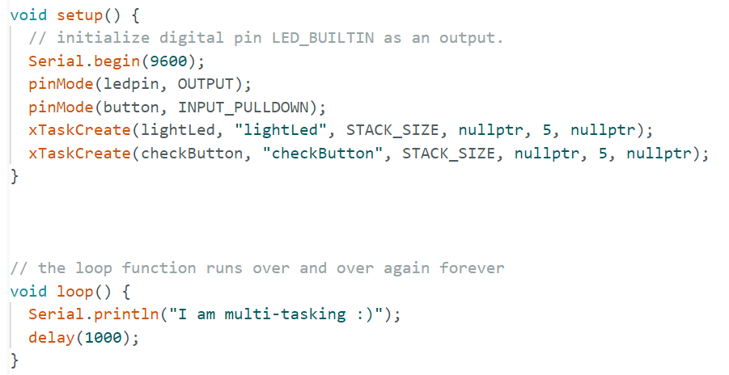
Example 2 – The code
Notes:
The code for this can be found in Github, the link is at the end of the presentation.

Slide 20
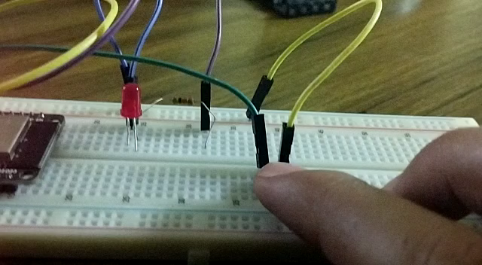
Example 3 – fading led
We are now interested in fading the light, but only when the button is clicked! if it is not clicked then hold.
This becomes a challenge using timers, but is a breeze using tasks.
Notes:
Code example in Github.

Slide 21
Exampel 4 – multiple fading leds
Raising the level of complexity, it becomes apparent why the use of tasks is a necessity:

Slide 22
1) Time concerns
We note that, although Free RTOS enables us to create as many tasks as we desire, ESP32, unlike more powerful chips, is a 2-core chip, meaning that it can only run 2 tasks at a time, moreover, one of the cores is used for the management WiFi, Bluetooth and Serial communication, meaning that tasks have overhead, so when creating tasks, think twice if the tasks at hand can be done synchronously without the use of multi-threading.

Slide 23
2) Space concerns
When creating a task, we pass stack size parameter to xTaskCreate(), be very careful not to overflow the stack (either with recursive calls or arrays), if a big array or a recursive function are needed, then do this in the main thread.
From experience, there is no good way to really know that the stack overflowing is what caused the crash, so try to avoid these kind of bugs as much as possible.

Slide 24
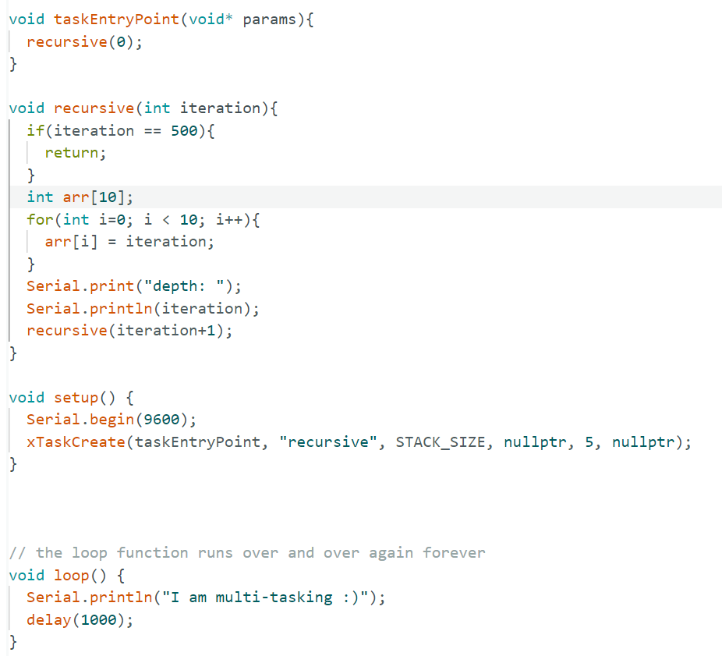
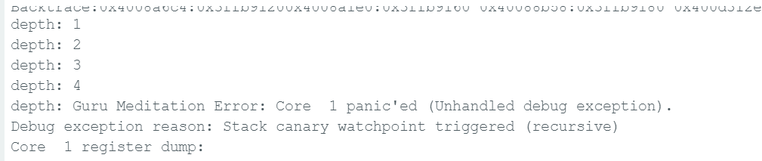
2) Space concerns - cont
This code runs a recursion, esp32 fails on the 4th call.

Slide 25
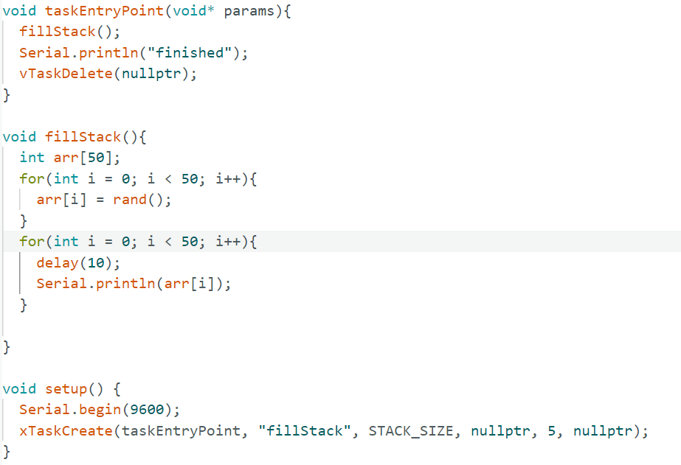
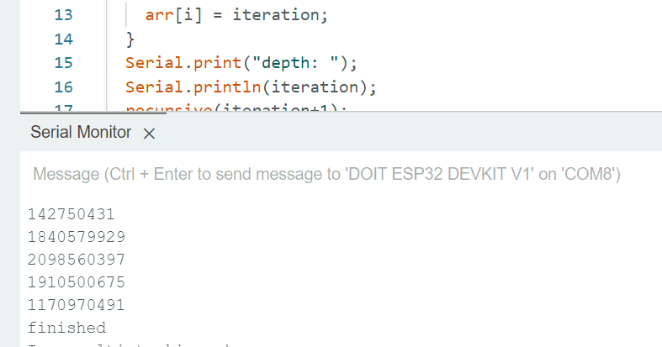
2) Cont - Another example for how sensitive task space allocation is:
Code allocates an array with 50 elements.
Works fine.

Slide 26
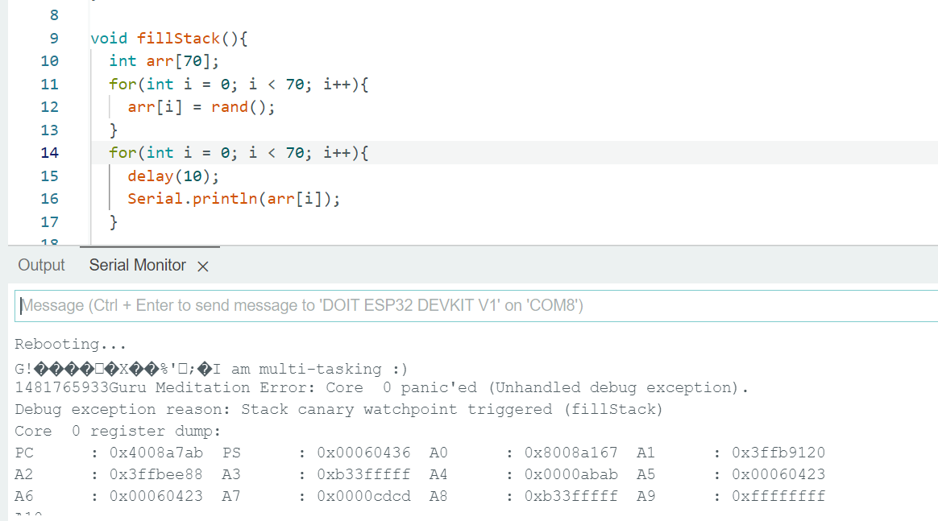
On 70 elements, the task crashes the chip:
Apparently, there is no way to debug this, so be very careful.

Slide 27
3) Scheduling concerns
Remember from OS course, context switches have an overhead! Avoid many threads with small code, write bigger code threads that preform a lot more when running.
Avoid delaying in microseconds, because delay yields the CPU, and so delaying for a small time makes the context switches costly, rather, use the normal delay().

Slide 28
אודות מצגת זו
א–
א

Slide 29
תוכן עניינים
1
2
3
4
a
b
c
d

Slide 30
סביבת עבודה
סביבות העבודה שניתן לעבוד בהן
Arduino IDE – הסביבה הפופולרית בעולם, נוחות התקנה ותאימות גבוהה, חסרים בה פיצ'רי נוחות של סביבות מודרניות כגון השלמה אוטומטית, highlighting קומפיילר, יכולת לקפוץ לקוד המקור של פונקציה וכדומה.
Arduino IDE 2.0 rc3- גרסא חדשה המאפשרת את רוב הפיצ'רים שהיו חסרים בגרסא הישנה. עדיין מעט איטית ולעתים לא יציבה.
Platform.io – סביבה קוד פתוח המיושמת כפלאג-אין ל-VSCode , נמצאת בשימוש נרחב. שלב ההגדרות הראשוניות לא הכי אינטואיטיבי למתחילים. מאפשרת לייצא פרויקט עם כל ה-dependencies שלו, מקל על שכפול הפרויקט.
Visual Micro – סביבה עם פיצ'רים מתקדמים, פחות בשימוש כיוון שהיא בתשלום (19 דולר ל-3 רשיונות לשנה) קיימות מצגות שלנו להתקנה ושימוש.

Slide 31
דגשים לעבודה עם ESP
א
Arduino

Slide 33


אודות מצגת זו
א–
א
מצגת זו עוסקת
מדריך זה

